Slide 1
Lab 1 : Introduction to Arduino
Asst. Prof. Dr.Sumek Wisayataksin
Faculty of Engineering
King Mongkut’s Institute of Technology Ladkrabang

Slide 2
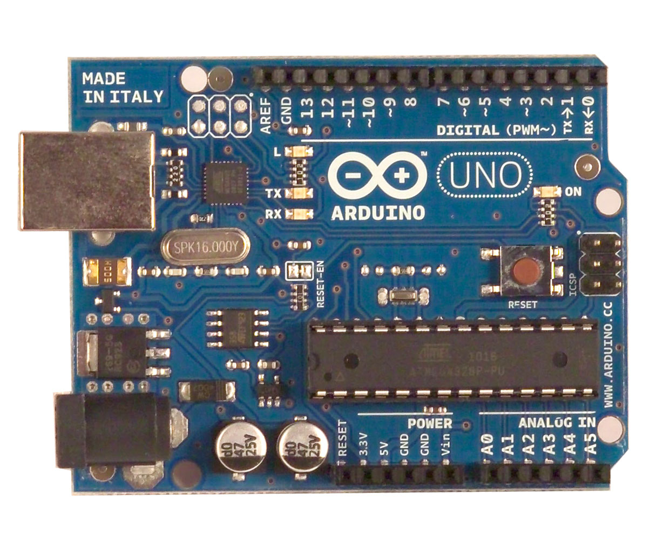

What is an Arduino ?
Open Source electronic prototyping platform based on flexible easy to use hardware and software.

Slide 3
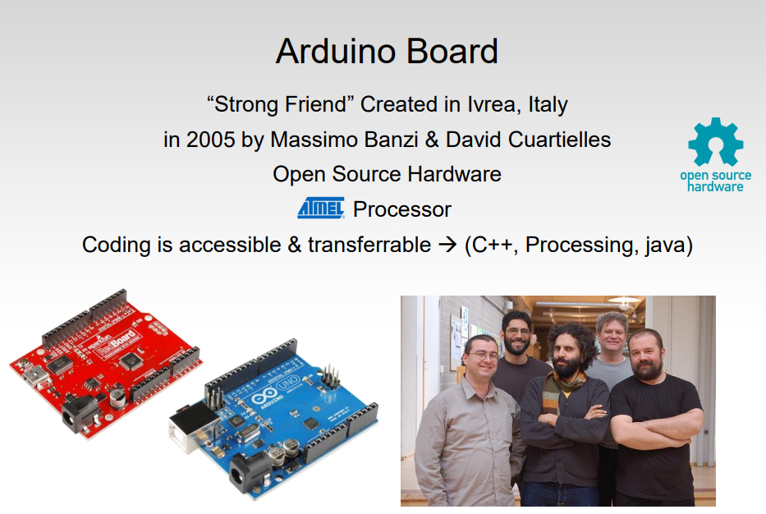
History

Slide 4
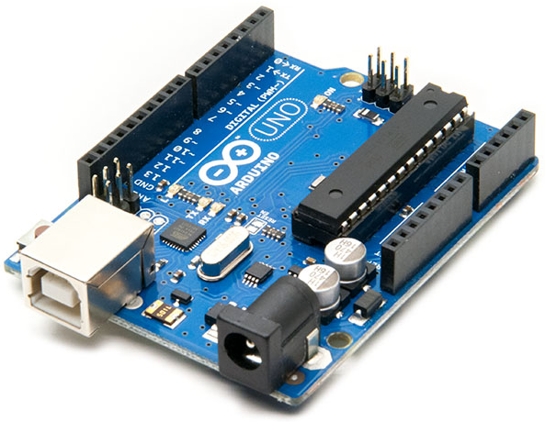
Type of Arduino
Arduino Uno Rev3
The Uno is a huge option for your initial Arduino. It consists of
14-digital I/O pins, where 6-pins can be used as PWM(pulse width modulation outputs)
6-analog inputs, a reset button
a power jack, a USB connection.
PC connection via USB cable

Slide 5
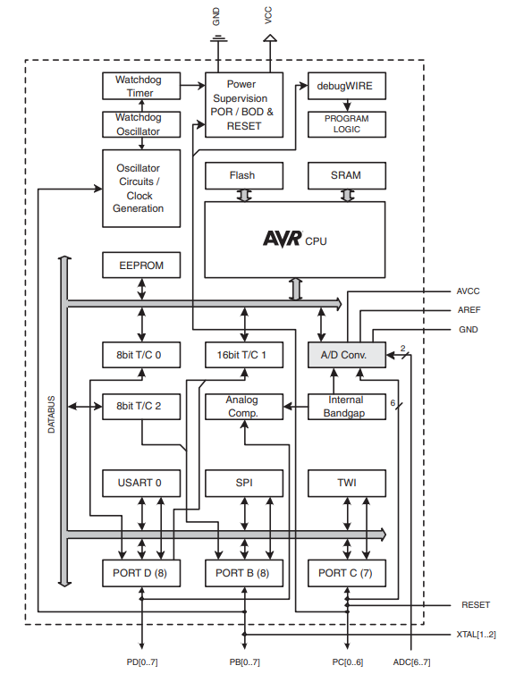
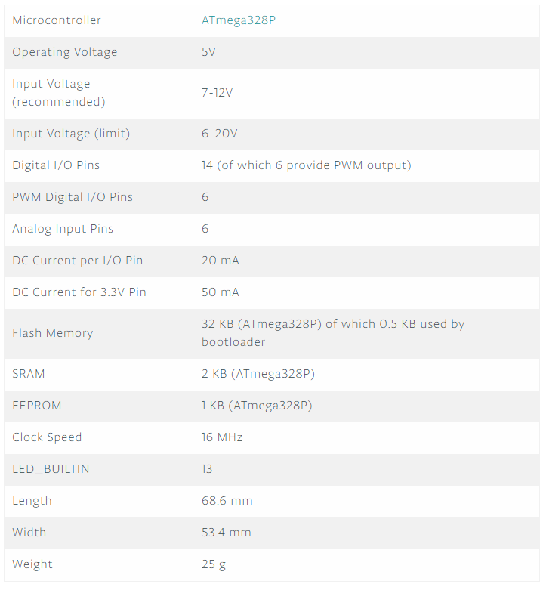
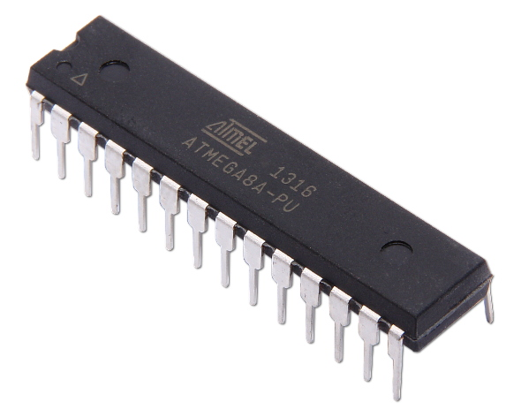
Arduino Uno Rev3 Specification

Slide 6
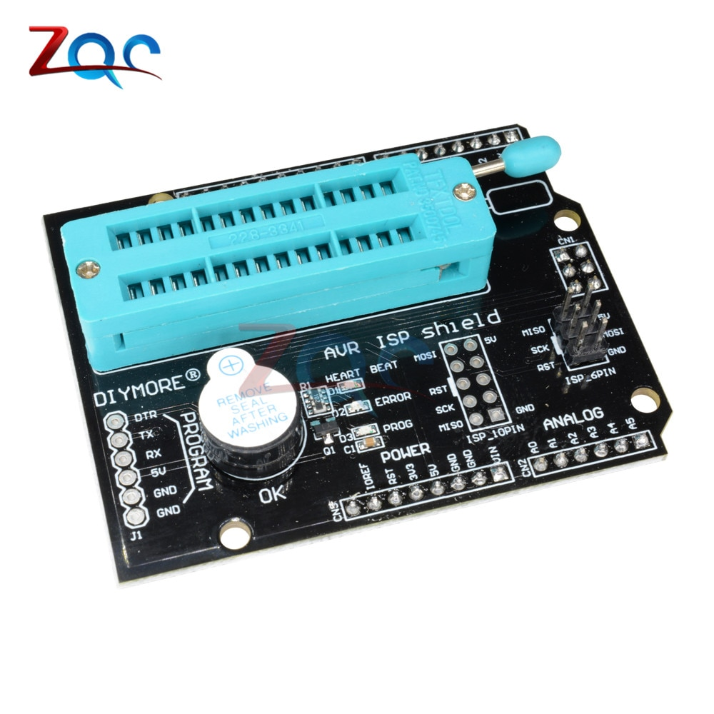
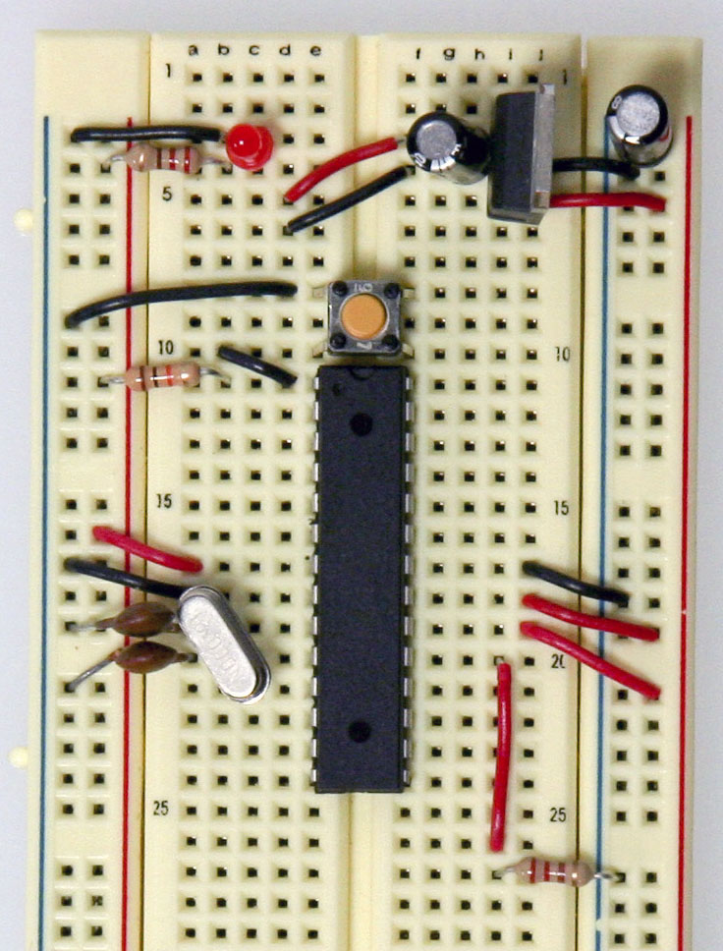
Microcontroller Before Arduino Board

Slide 7
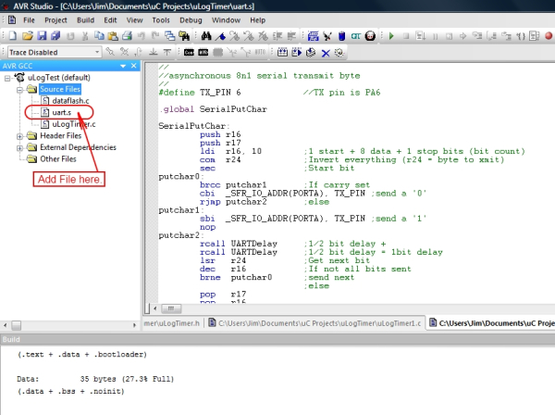
Microcontroller Before Arduino Board
Assembly Programming

Slide 8
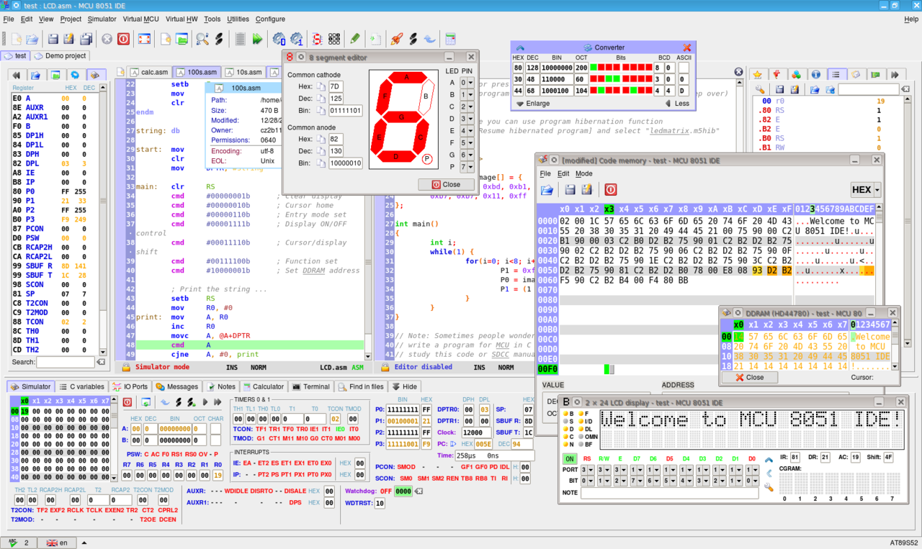
Microcontroller Before Arduino Board

Slide 9
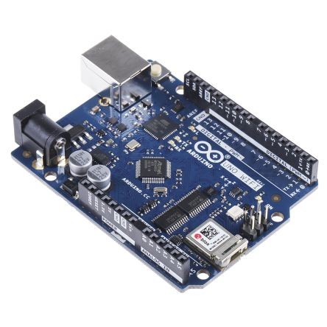
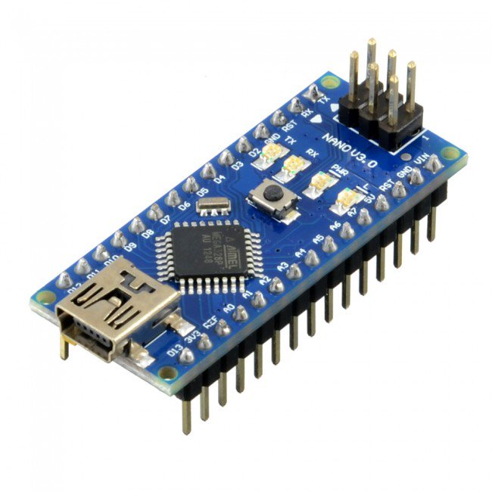
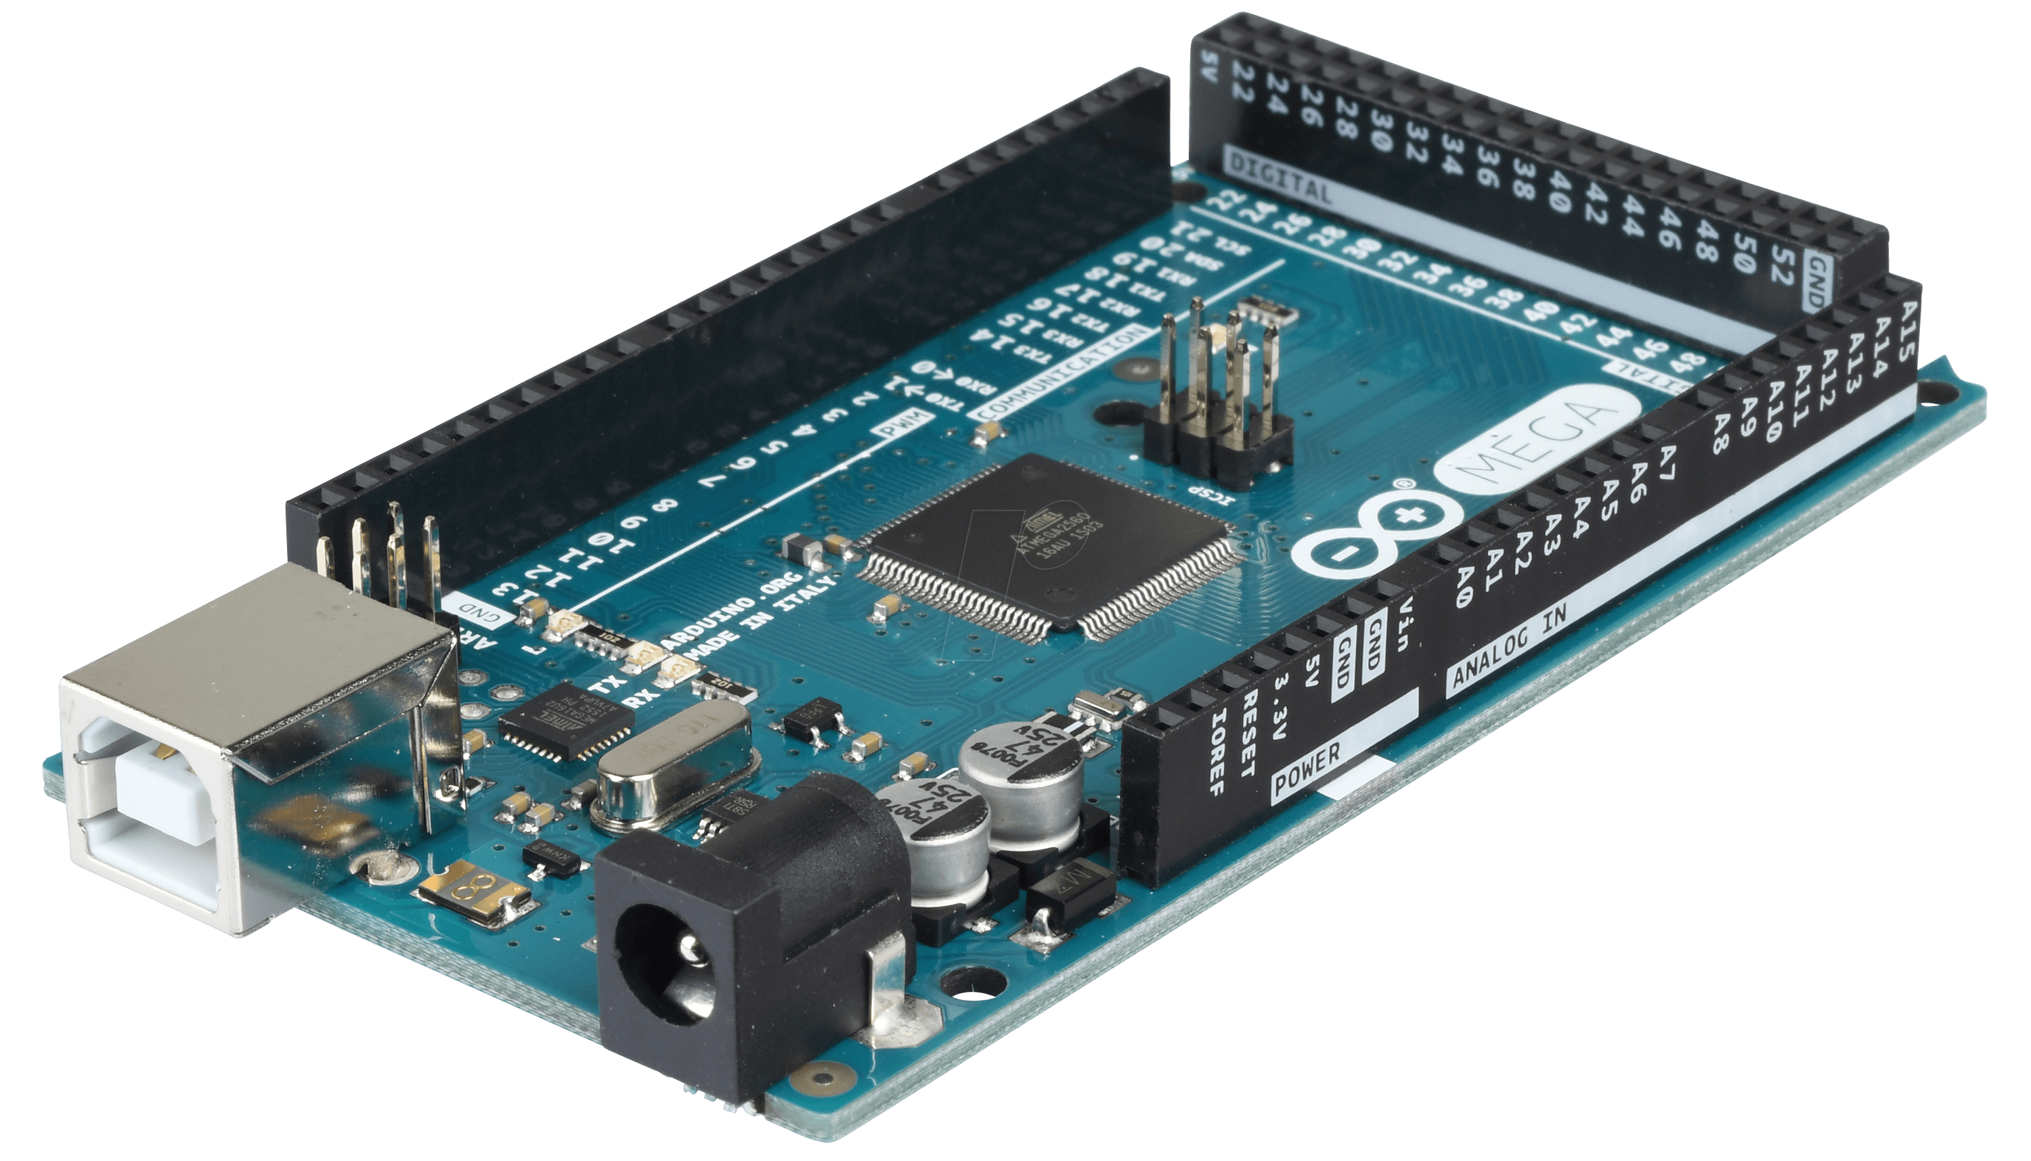
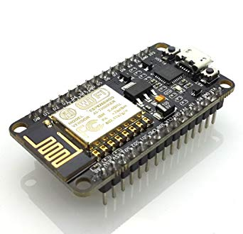
Other Arduino Boards and Microcontrollers
Arduino Nano
Arduino Uno WIFI
Arduino Mega
NodeMCU ESP32
- Xtensa dual-core (or single-core) 32-bit LX6 microprocessor, operating at 160 or 240 MHz
- Wi-Fi: 802.11 b/g/n
- Bluetooth: v4.2 BR/EDR and BLE
520 KiB SRAM

Slide 10
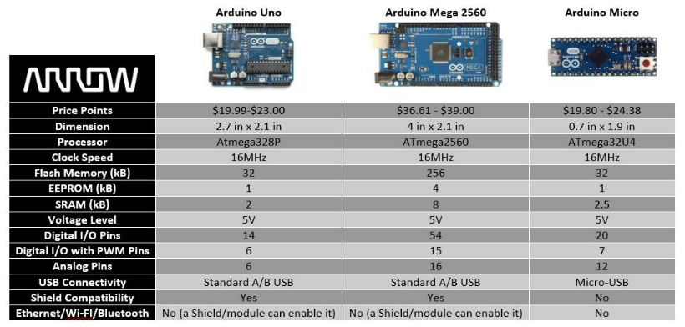
Arduino Board Comparison

Slide 11
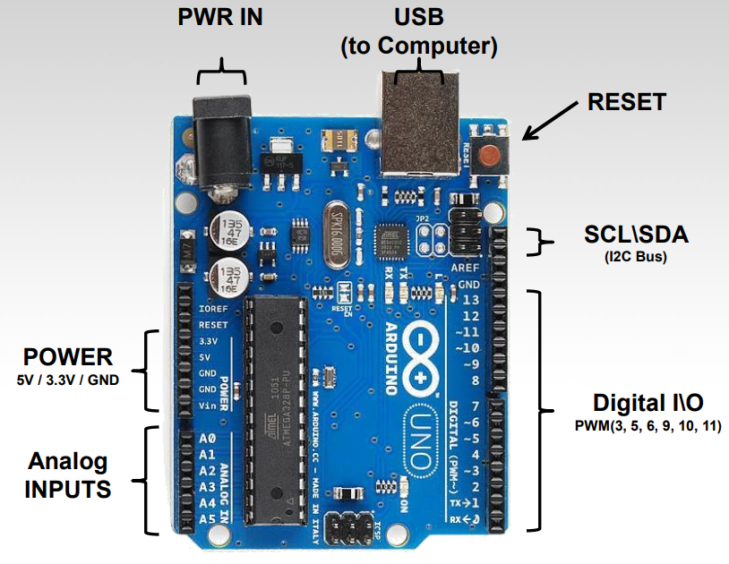
Arduino Uno Structure

Slide 12
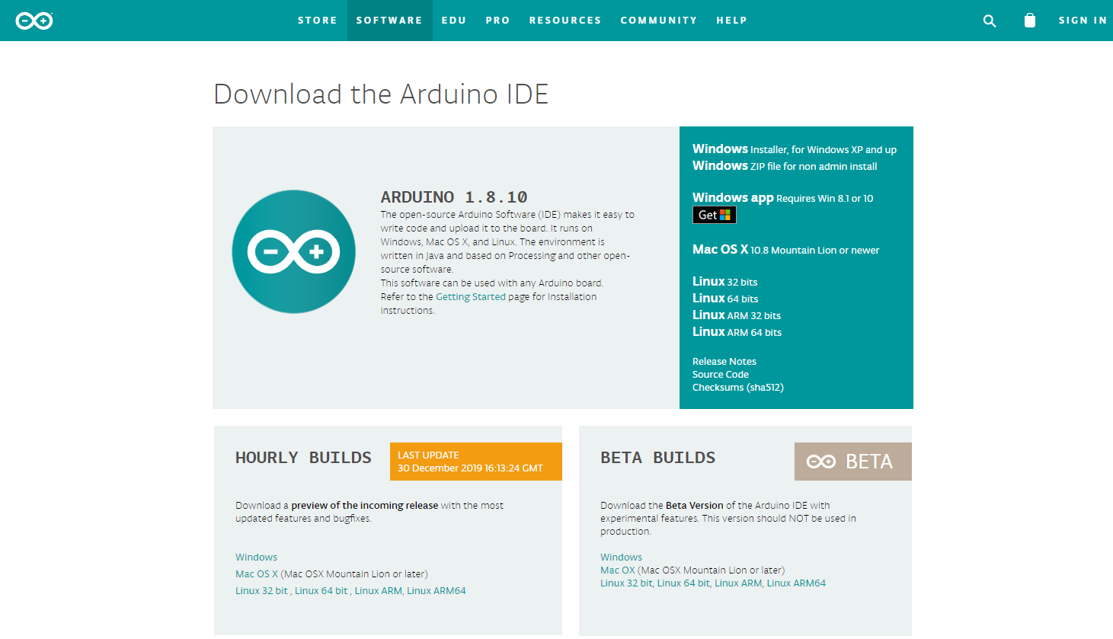
Arduino IDE -> www.arduino.cc

Slide 13
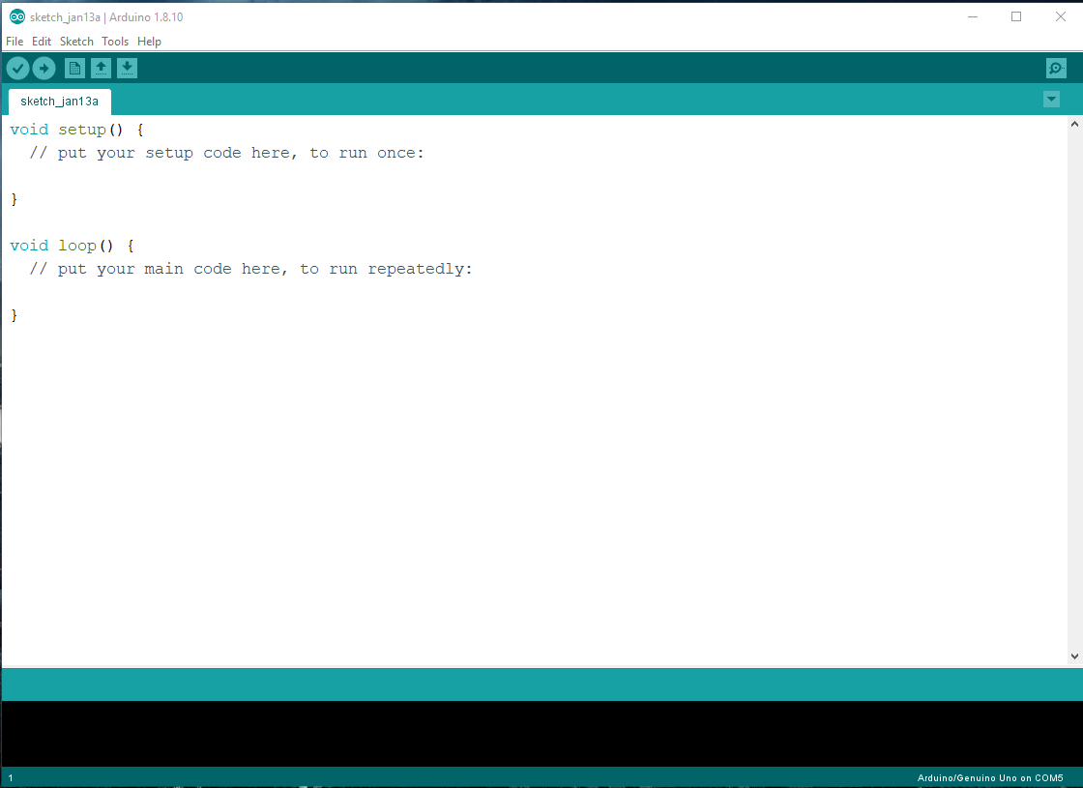
Arduino IDE
Compile Code
Upload Code
(Program Flash Memory

Slide 14
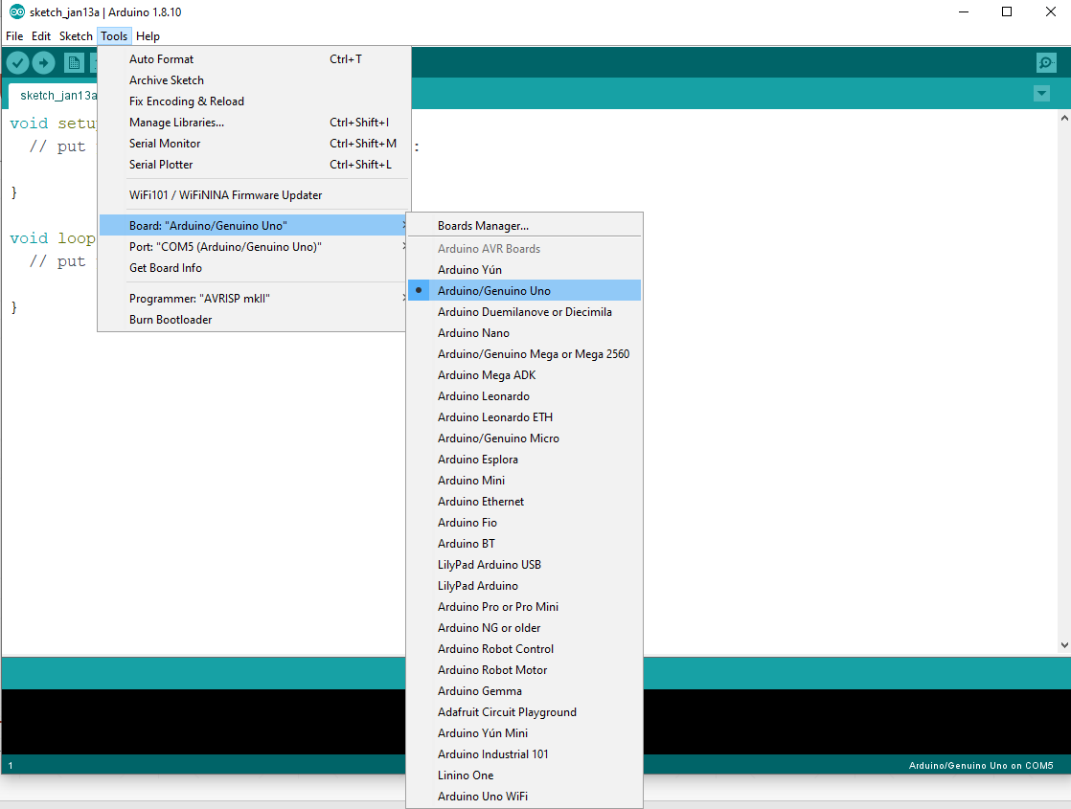
Arduino IDE
Select Board

Slide 15
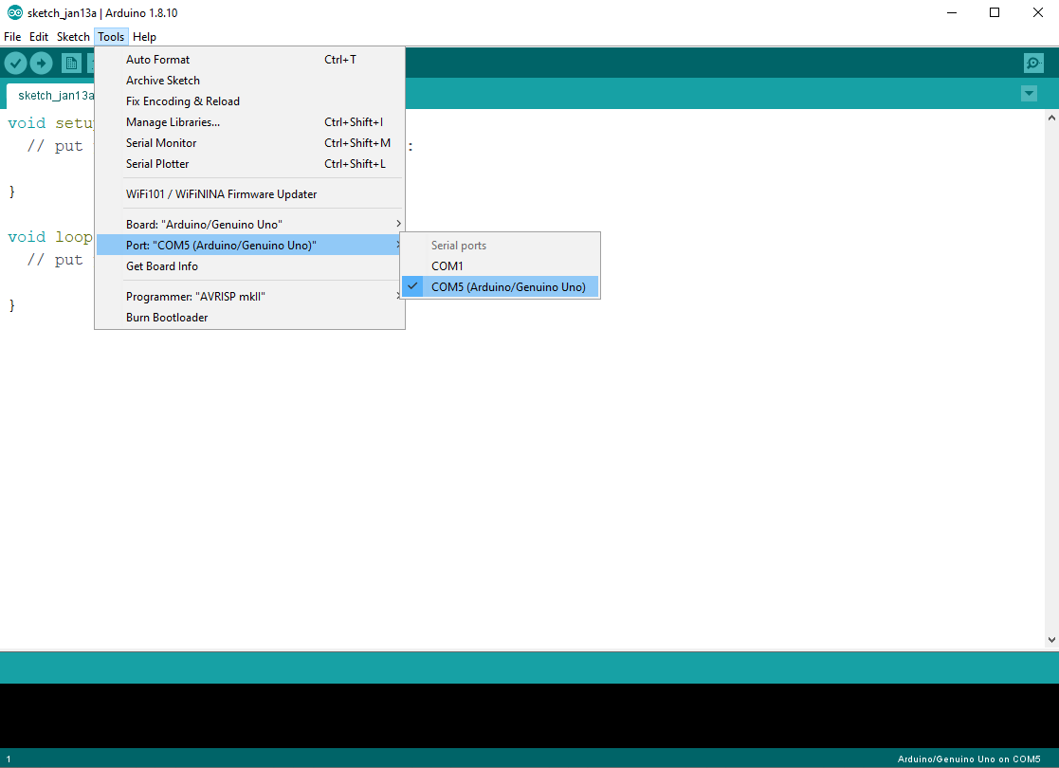
Arduino IDE
Select Serial Port Connection

Slide 16
Arduino Programming
Bare minimum code
void setup() { // put your setup code here, to run once:
}
void loop() { // put your main code here, to run repeatedly:
}

Slide 17
Bare minimum code
setup : It is called only when the Arduino is powered on or reset. It is used to initialize variables and pin modes
loop : The loop functions runs continuously till the device is powered off. The main logic of the code goes here. Similar to while (1) for micro-controller programming.

Slide 18
PinMode
A pin on Arduino can be set as input or output by using pinMode function.
pinMode(13, OUTPUT); // sets pin 13 as output pin
pinMode(13, INPUT); // sets pin 13 as input pin

Slide 19
Writing Digital Values
digitalWrite(13, LOW); // Makes the output voltage on pin 13 , 0V
digitalWrite(13, HIGH); // Makes the output voltage on pin 13 , 5V

Slide 20
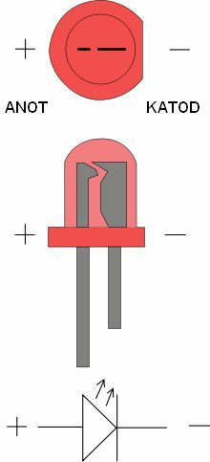
LED (Light-Emitting Diode)
a semiconductor light source that emits light when current flows through it.
The color of the light (corresponding to the energy of the photons) is determined by the energy required for electrons to cross the band gap of the semiconductor.

Slide 21
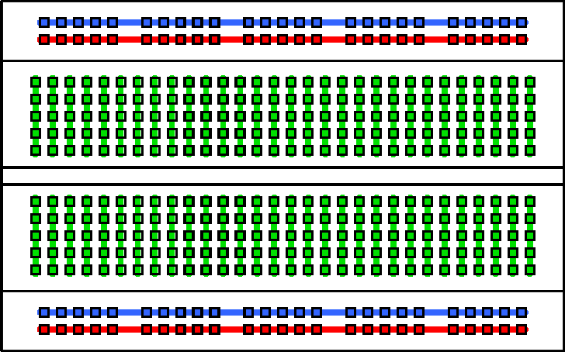
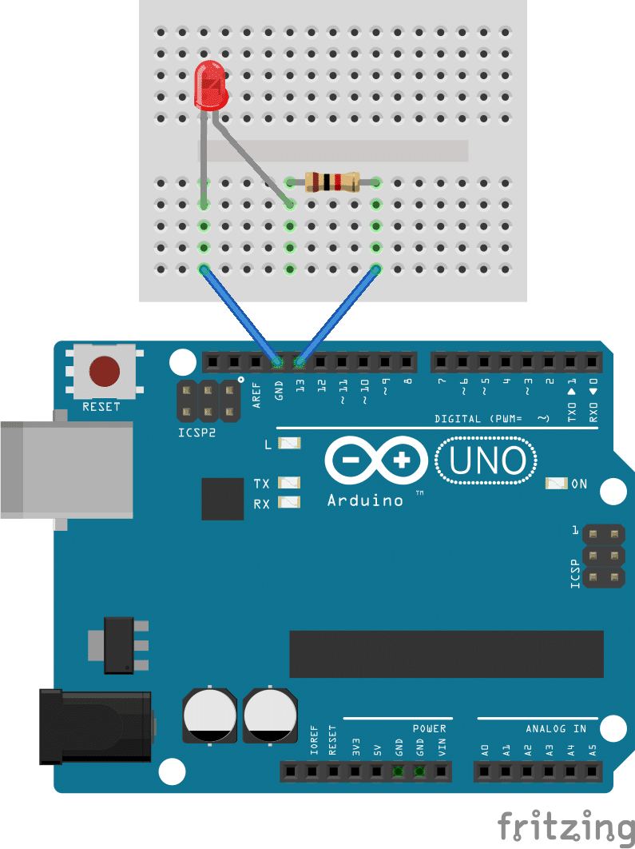
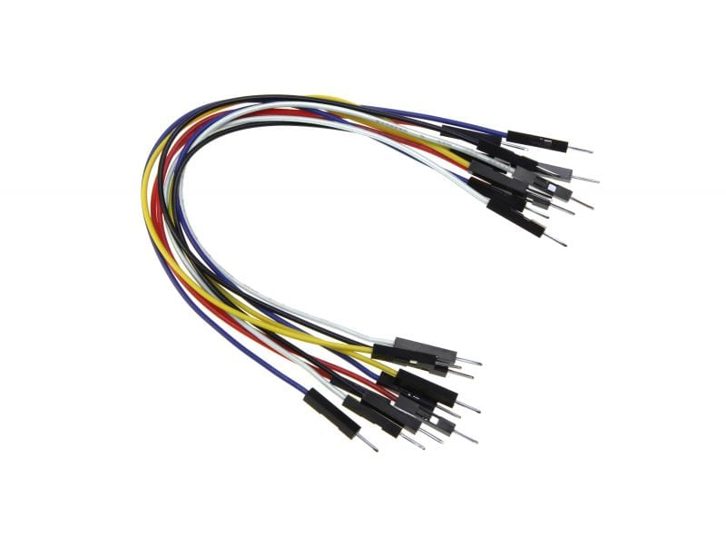
LAB 1.1 : LED Control
Breadboard

Slide 22
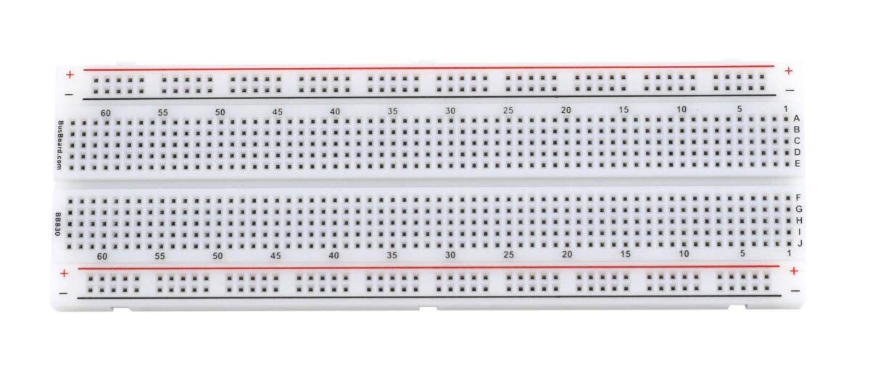
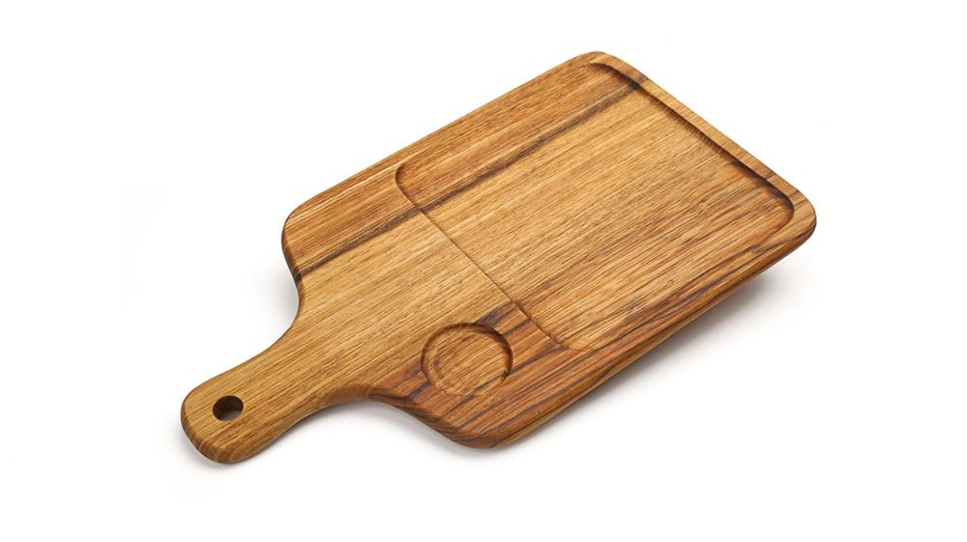
Breadboard or Protoboard

Slide 23
LAB 1.1 : LED Control
void setup()
{
pinMode(13, OUTPUT);
}
void loop()
{
digitalWrite(13, HIGH);
delay(1000);
digitalWrite(13, LOW);
delay(1000);
}
220 Ohm

Slide 24
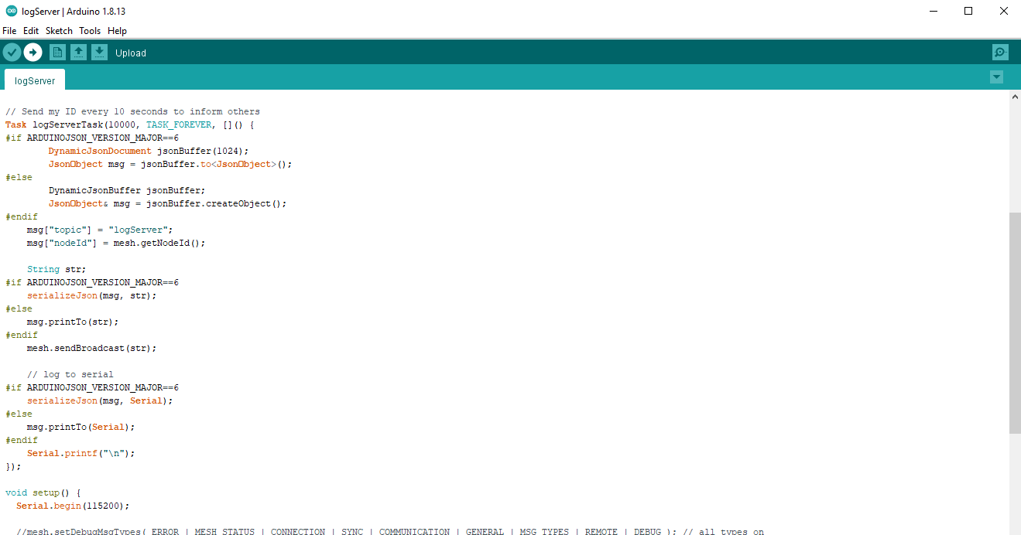
How to compile and upload code

Slide 25
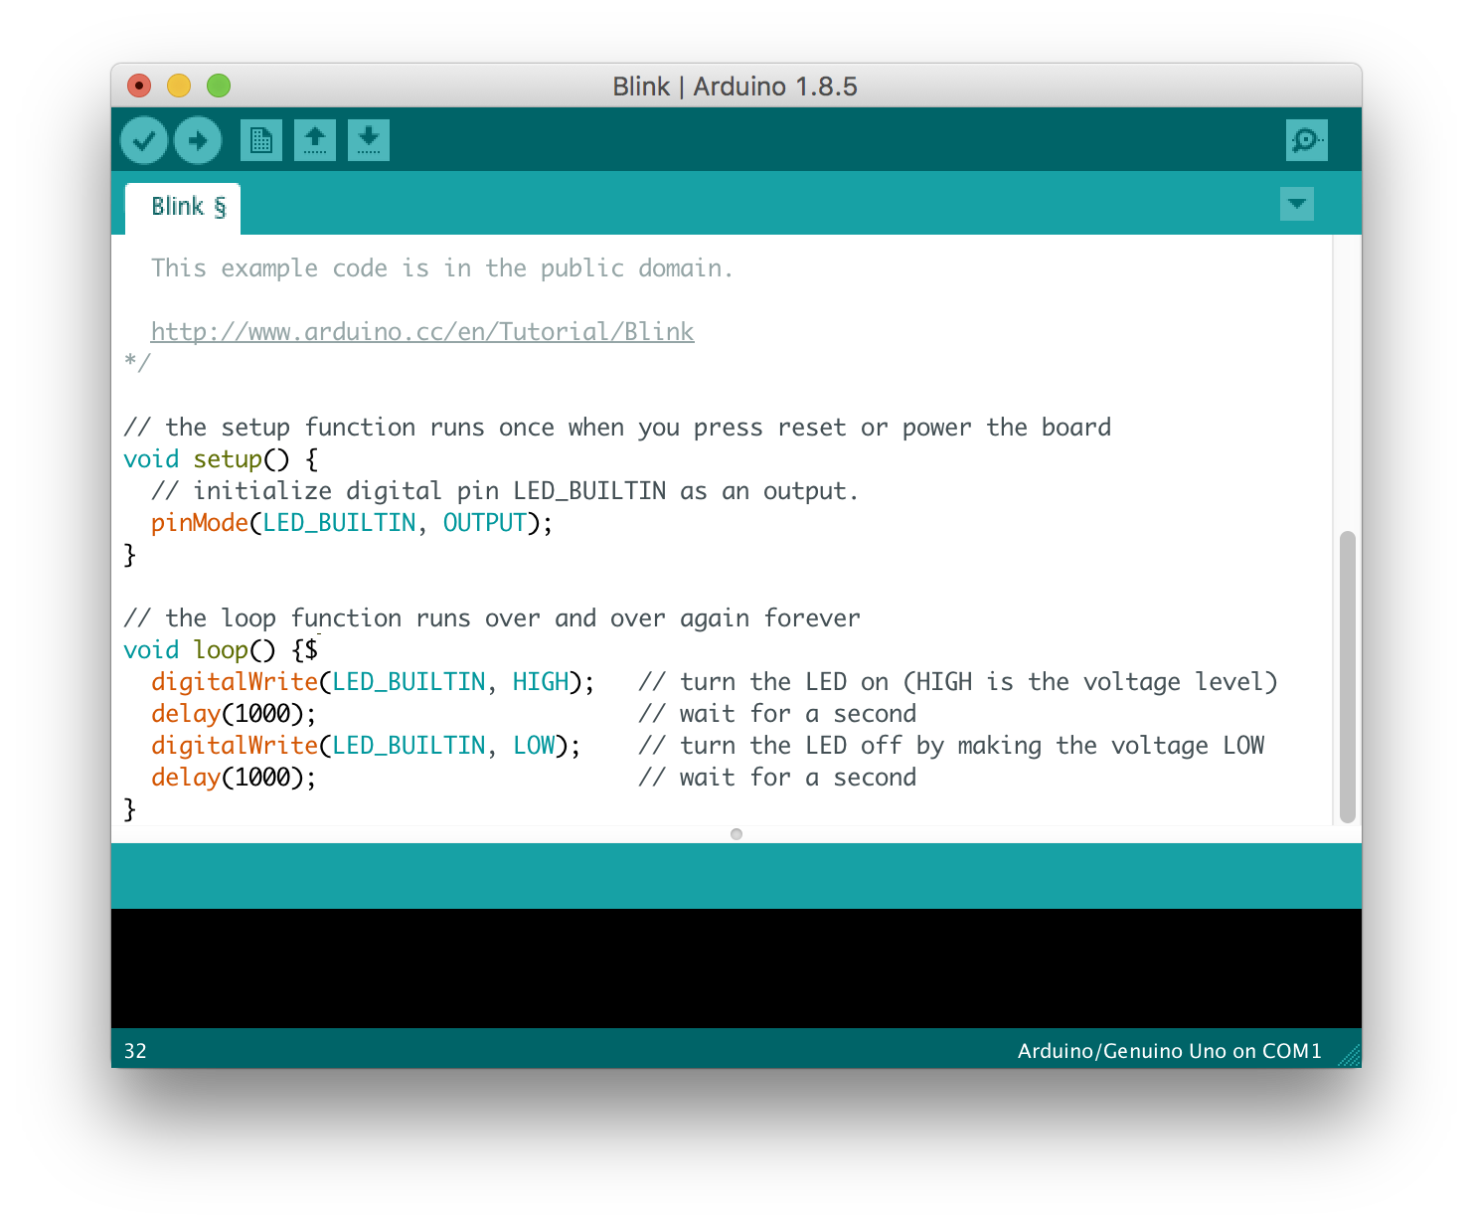
How to submit your work
1. Submit your code.

Slide 26
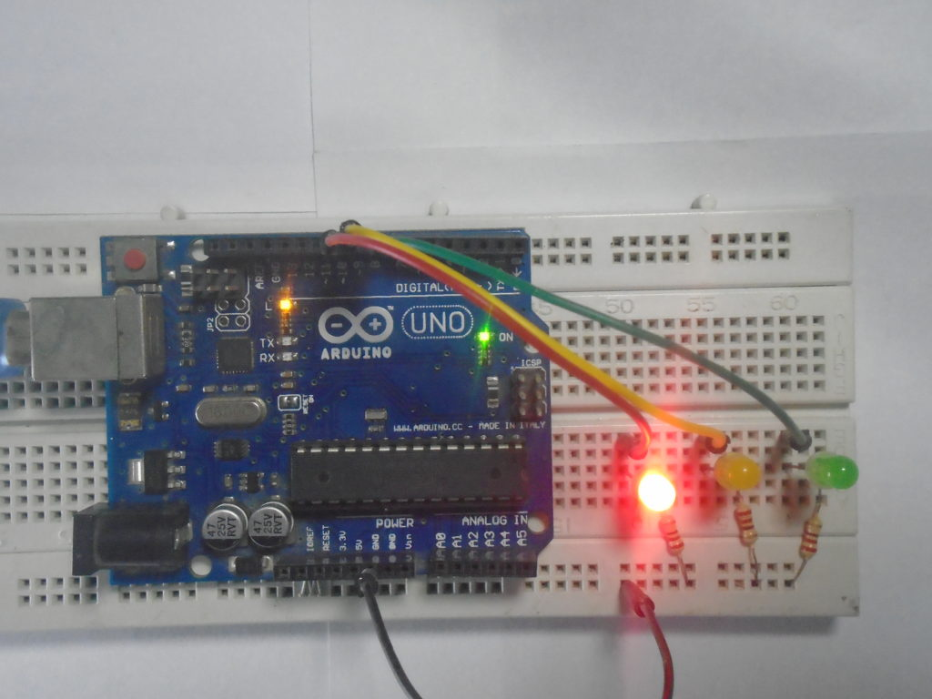
How to submit your work
2. Submit your hardware pictures.

Slide 27
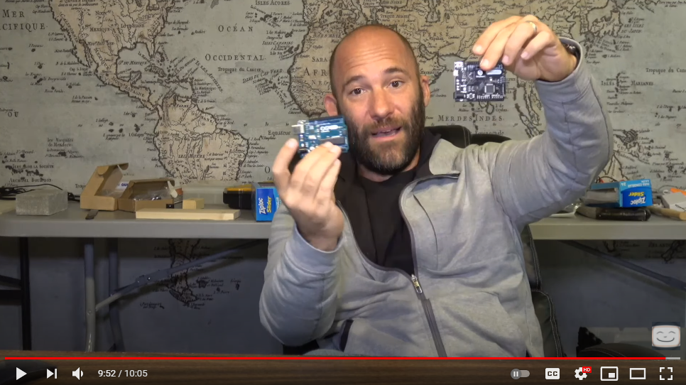
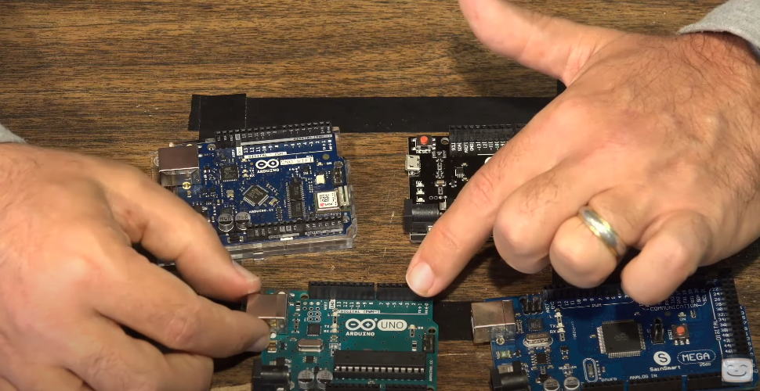
How to submit your work
3. Submit video showing how it works (with yourself in the video).

Slide 28
Reading Digital Values
pinMode(2, INPUT); // sets pin 2 as input pin
buttonState = digitalRead(2); // reads the value of pin 2

Slide 29
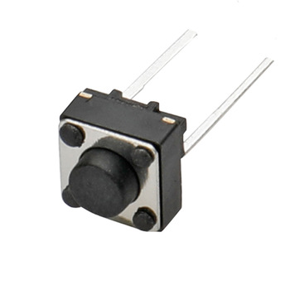
Push Button
Not Push
Push
Open Circuit
Short Circuit

Slide 30
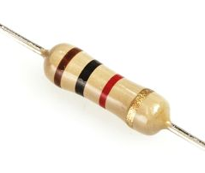
Push Button
5V (Logic 1)
5V (Logic 1)
Not Push
Push
Arduino Input
Arduino Input
Logic ???
Arduino Input
Logic ???
GND (Logic 0)
GND
(Logic 0)
GND
(Logic 0)
5V (Logic 1)

Slide 31
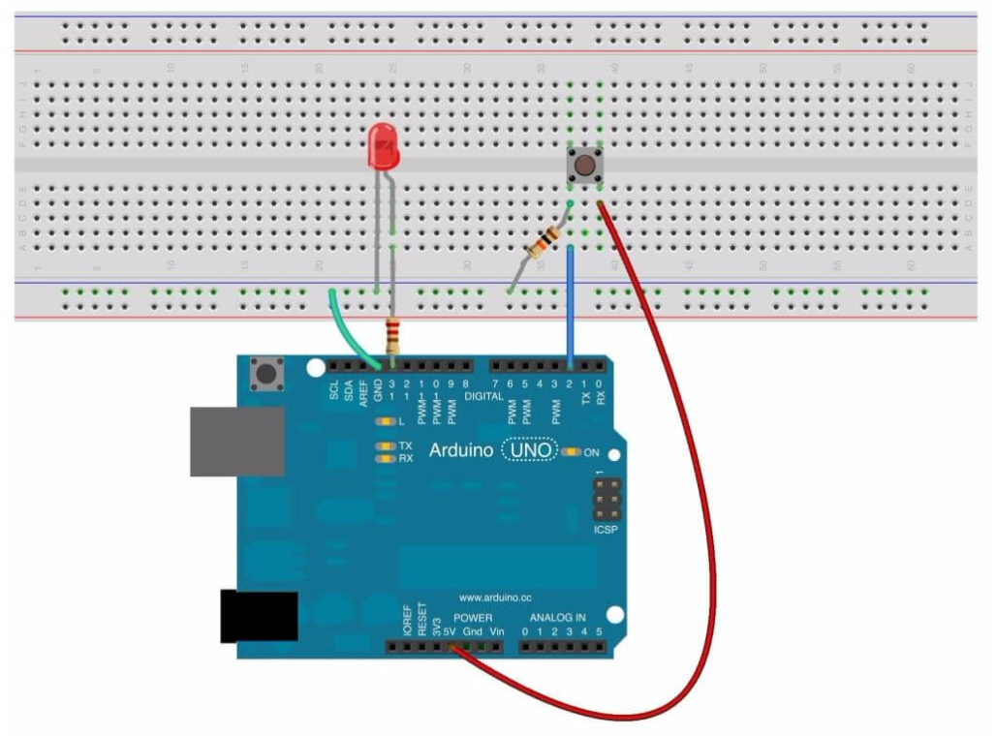
LAB 1.2 : Reading Digital Values
10kOhm
char status;
void setup()
{
pinMode(13,OUTPUT);
pinMode(2, INPUT);
}
void loop()
{
status = digitalRead(2);
// Add your code here
}
220Ohm

Slide 32
Arduino C Variables
char : 8-bit number value from -128 to 127.
unsigned char : 8-bit number from 0 to 255.
int : 16-bit number from -32768 to 32767.
unsigned int : 16-bit number from 0 to 65536.
float : real number with floating point.

Slide 33
Basic C Structure
While loop
While (digitalRead(2)==1)
{
// Do until digitalRead(2)!=0
}

Slide 34
Basic C Structure
For loop
char i;
for (i=0;i<10;i++);
{
// Do from i==0 until i==9
// Totally 10 times
}

Slide 35
Basic C Structure
If statement
if (digitalRead(2)==1)
{
// Do when digitalRead(2) == 1;
}
else
{
// Do when digitalRead(2) == 0;
}

Slide 36
Basic C Structure
switch statement
char case;
switch (case)
{
case 0 : { // Do something; break;}
case 1 : { // Do something; break;}
case 2 : { // Do something; break;}
case 3 : { // Do something; break;}
default : { // Do something; break;}
}

Slide 37
LAB 1.3 : Arduino Port Test
Condition
Connect Arduino with 3 LEDs : Red, Yellow and Green.
Connect 1 push button.
When Arduino starts no LED on.
When button is pushed and released -> Red on, Yellow off , Green off
When button is pushed and released again -> Red Off, Yellow on , Green off
When button is pushed and released again -> Red Off, Yellow off , Green on
When button is pushed and released again -> Back to 4.

Slide 38
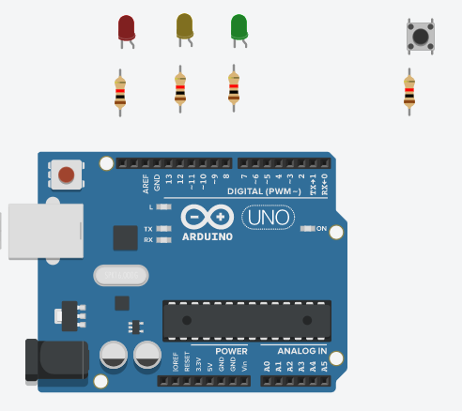
LAB 1.3 : Arduino Port Test

Slide 39
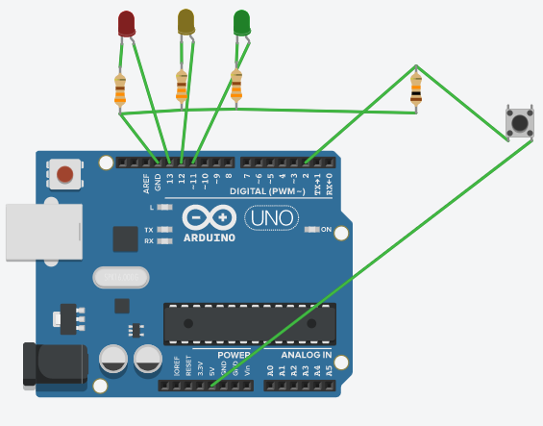
LAB 1.3 : Arduino Port Test

